Slide 1
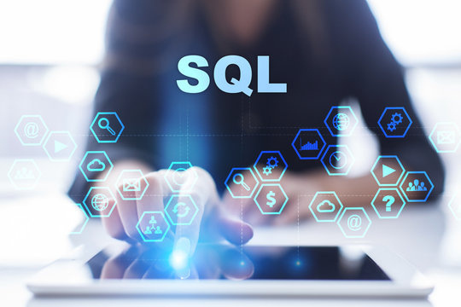


TEXT TO SQL
NATURAL LANGUAGE QUERY USING GENAI
Presented by:
Manoj Kumar S

Slide 2


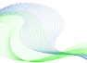
INTRODUCTION
Text-to-SQL is a task in natural language processing (NLP) where the goal is to automatically generate SQL queries from natural language text.
Imagine being able to ask a question about your data in plain English, and having the system automatically translate that into a perfectly formed SQL query! That's the power of text-to-SQL.

Slide 3




OUR VALUES
VISION
MISSION
Create a future where anyone can effortlessly interact with and analyze data using natural language.
Empowering anyone to analyze data without needing complex programming.

Slide 4

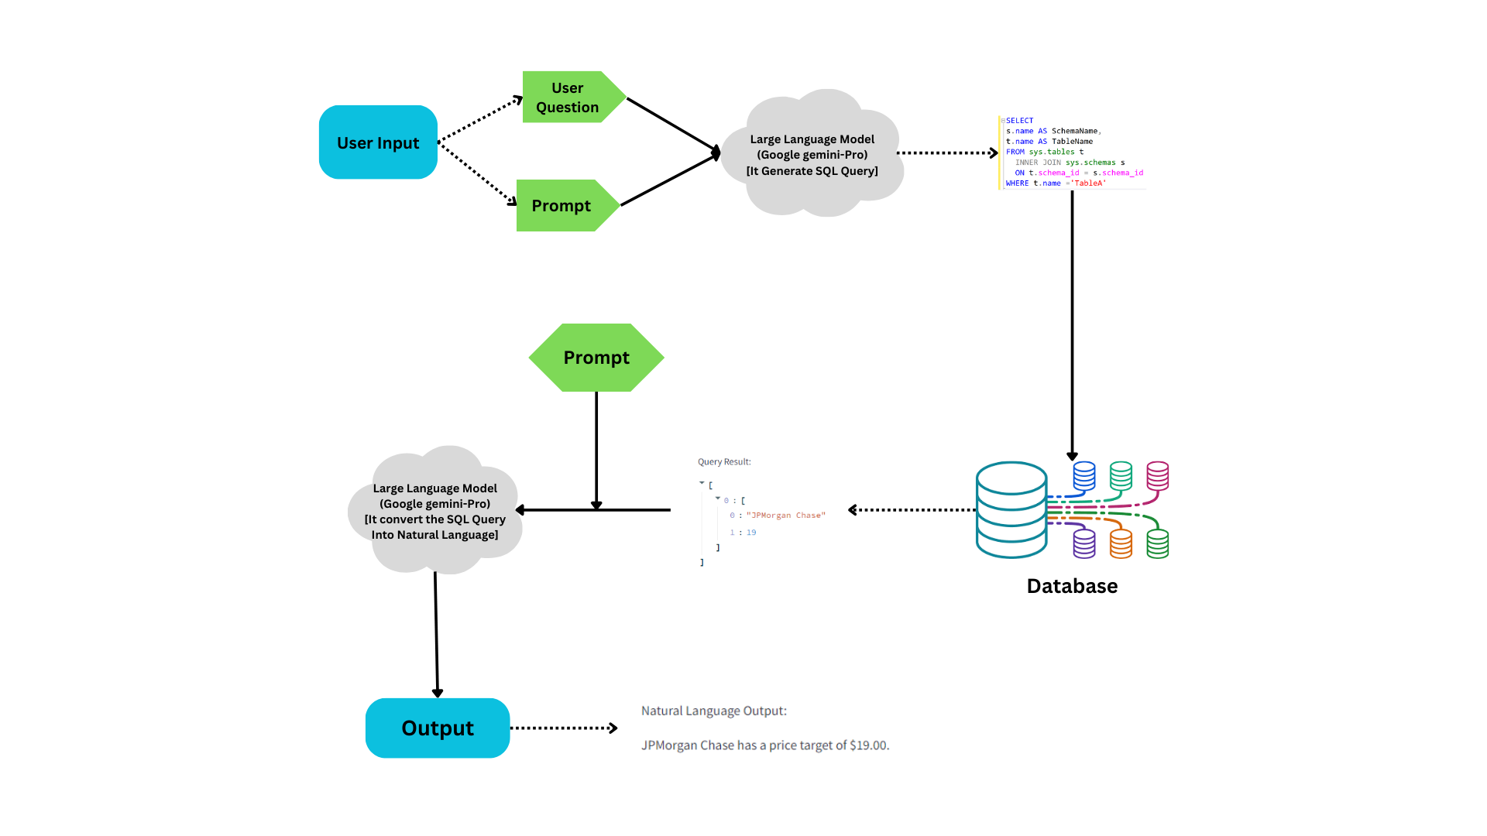

Slide 5


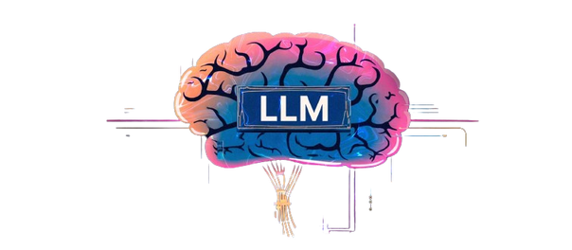


MODULES
Python
SQL
Large Language Model
Streamlit

Slide 6
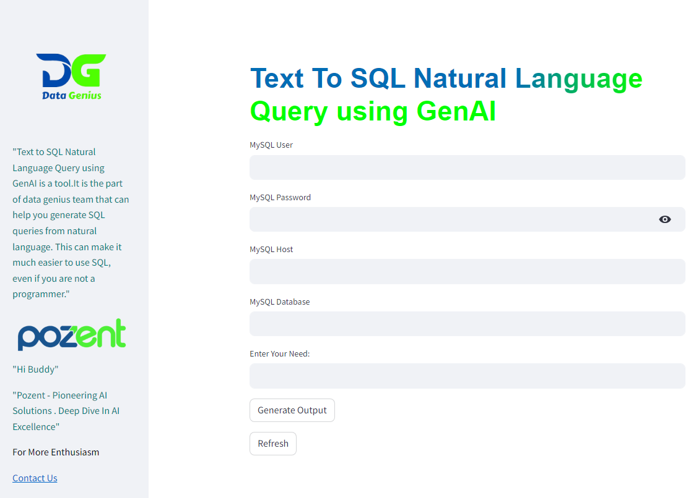



USER INTERFACE

Slide 7
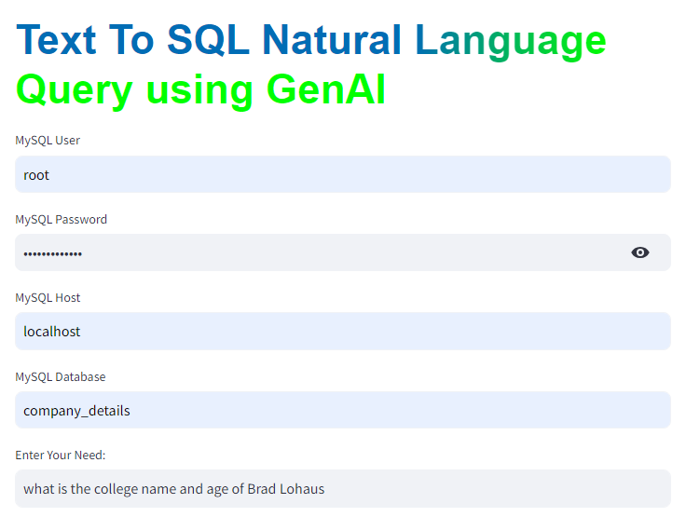
USER INPUT

Slide 8
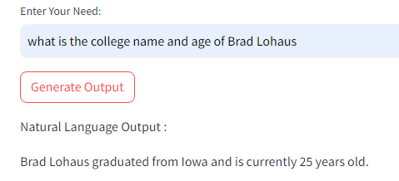
NATURAL LANGUAGE OUTPUT

Slide 9
ENHANCEMENT
Multiple Databases :
Connect multiple databases to access the information by natural language.

Slide 10



THANK
YOU

